Slide 1
02
Spark-shell 구동

Slide 2

2. Spark-shell 구동
9.vagrant 시작
(D:\vagrant에서 실행)
------------------------------------------------------------------------------------
d:\vagrantvagrant up
D:\vagrant>vagrant up
Bringing machine 'default' up with 'virtualbox' provider...
==> default: Importing base box 'manning/spark-in-action'...
==> default: Matching MAC address for NAT networking...
==> default: Setting the name of the VM: vagrant_default_1626927920738_29793
Vagrant is currently configured to create VirtualBox synced folders with
the `SharedFoldersEnableSymlinksCreate` option enabled. If the Vagrant
guest is not trusted, you may want to disable this option. For more
information on this option, please refer to the VirtualBox manual:

Slide 3
2. Vagrant 접속
10. 실행
D:\vagrant>vagrant ssh -- -l spark <-- 입력!!
==> default: The machine you're attempting to SSH into is configured to use
==> default: password-based authentication. Vagrant can't script entering the
==> default: password for you. If you're prompted for a password, please enter
==> default: the same password you have configured in the Vagrantfile.
vagrant@127.0.0.1's password:
vagrant@127.0.0.1's password:
Welcome to Ubuntu 14.04.4 LTS (GNU/Linux 3.13.0-85-generic x86_64)

Slide 4
2. Vagrant 접속
10. 실행
D:\vagrant>vagrant ssh -- -l spark <-- 입력!!
==> default: The machine you're attempting to SSH into is configured to use
==> default: password-based authentication. Vagrant can't script entering the
==> default: password for you. If you're prompted for a password, please enter
==> default: the same password you have configured in the Vagrantfile.
vagrant@127.0.0.1's password:
vagrant@127.0.0.1's password:
Welcome to Ubuntu 14.04.4 LTS (GNU/Linux 3.13.0-85-generic x86_64)

Slide 5
2. Spark-shell 접속
11. spark-shell 띄우기
가상머신에서 spark/spark 로 login
-----------------------------------------------
>>>
spark@spark-in-action~$_
$spark-shell
scala>_
-----------------------------------------------
위 화면이 뜨면 OK~~~

Slide 6
2. Pyspark 실행
12.pyspark 띄우기
$pyspark
>>>
-----------------------------------------------
위 화면이 뜨면 OK~~~

Slide 7
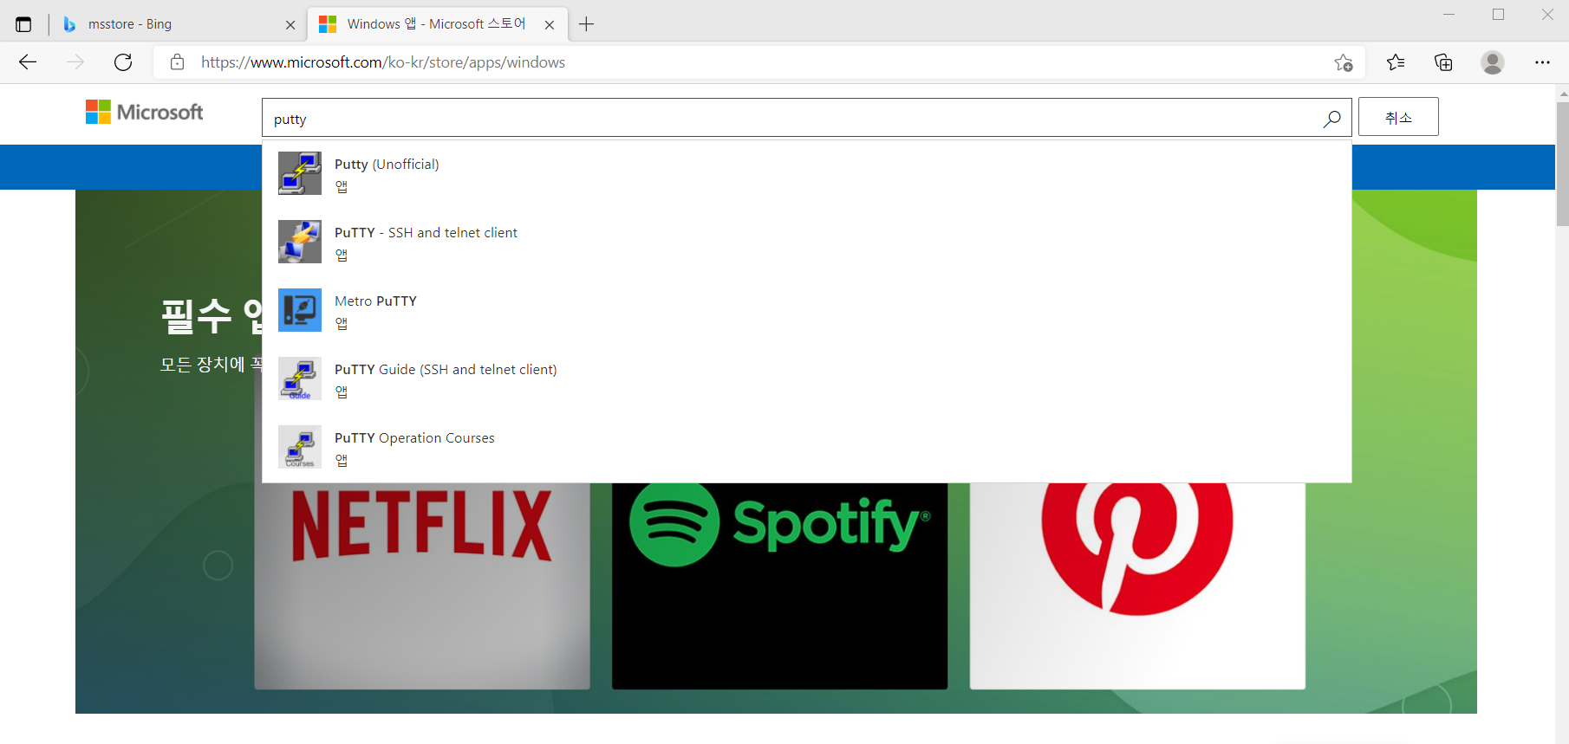
2. Putty 설치
13.Msstore에서 putty 검색 후 설치
URL : https://www.microsoft.com/ko-kr/store/apps/windows

Slide 8
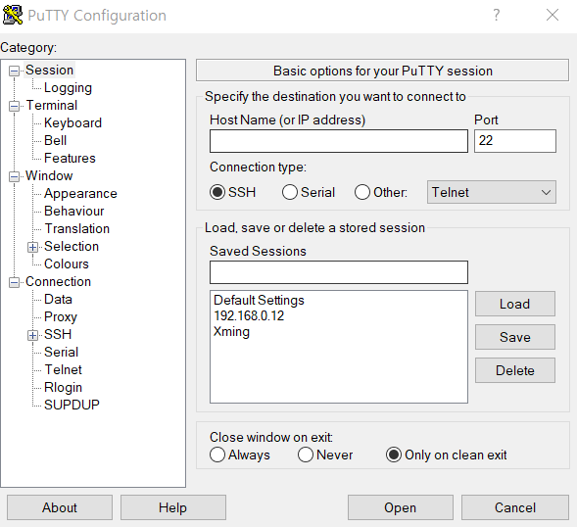
2. Putty 설치
13. 설치 후 아래와 같이 address 설정
address를 192.168.0.12 로 설정하고 port는 22

Slide 9
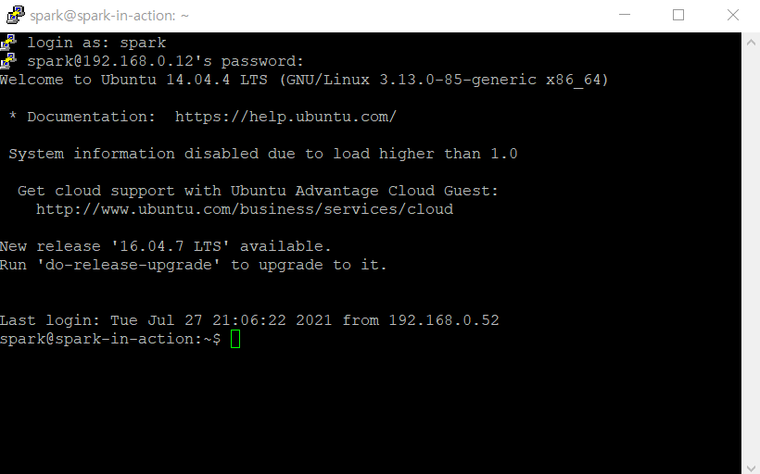
2. Spark login
13. Spark 를 putty로 login
Login : spark
Password : spark

Slide 10
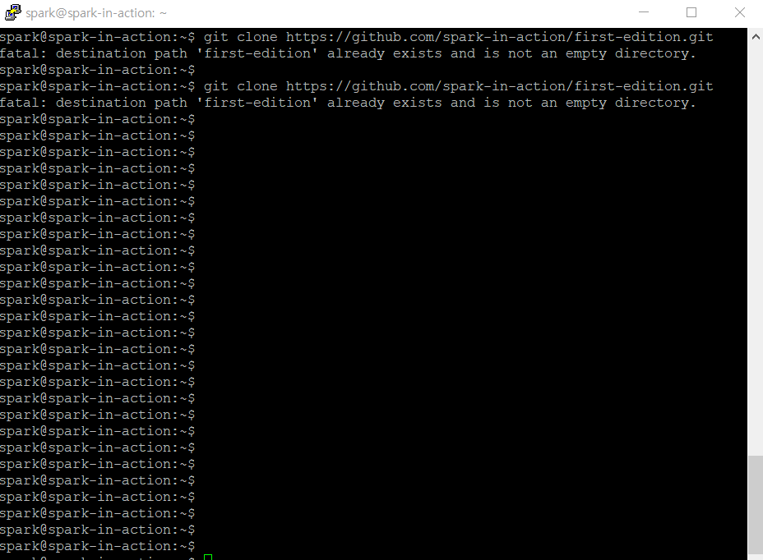
2.깃허브 저장소 복제
13. Linux 환경에서 실습 파일 download
$ git clone https://github.com/spark-in-action/first-edition.git
(이미 box에 설치 되어 있다.)

Slide 11
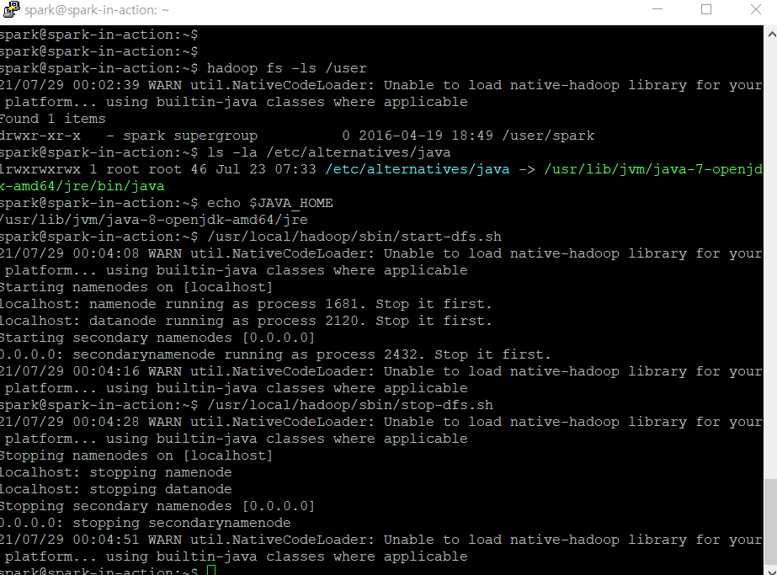
2.Java 환경 점검 & Hadoop 데몬 기동
13. Linux 환경에서 java HOME 보기 및 Hadoop 기동 및 정지
# section 2.1.1
which java
ls -la /usr/bin/java
ls -la /etc/alternatives/java
echo $JAVA_HOME
# section 2.1.2hadoop fs -ls /user
# /usr/local/hadoop/sbin/start-dfs.sh
# /usr/local/hadoop/sbin/stop-dfs.sh
# section 2.1.3
ls /opt | grep spark
# Example of how to replace symbolic link
# to point to a different version of Spark:
# sudo rm -f /usr/local/spark
# sudo ln -s /opt/spark-1.5.0-bin-hadoop2.4 /usr/local/spark
export | grep SPARK

